Slide 1

Data Visualization
src: https://dppucryp3i-flywheel.netdna-ssl.com/wp-content/uploads/2015/06/a-picture-is-worth-a-thousand-word-640x321.jpg

Slide 2
Data Visualization
❑ Refers to the techniques used to communicate data or information by encoding it as visual objects (e.g., points , lines or bars) contained in graphics
❑ Goal is to communicate information clearly and efficiently to users
We love the tangible, the confirmation, the palpable, the real, the visible, the concrete, the known, the seen, the vivid, the visual, … - Black Swan, Nassim Nicholas Taleb
Reference: https://en.wikipedia.org/wiki/Data_visualization

Slide 3

Data Visualization
❑ Especially useful in two steps of data mining
Data Understanding (Exploratory research)
Deployment (Communication of results)
src: https://en.wikipedia.org/wiki/Cross-industry_standard_process_for_data_mining#/media/File:CRISP-DM_Process_Diagram.png

Slide 4
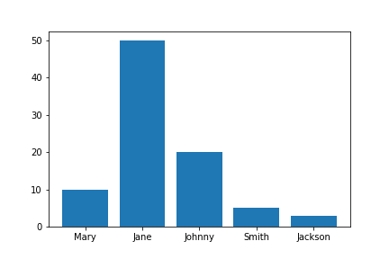
Motivating Examples
❑ Words: “Jane has 50 apples, while Mary and Johnny has only 10 and 20”
❑ Picture

Slide 5
Motivating Examples
❑ Words: “Jane has 50 apples, while Mary and Johnny has only 10 and 20”
❑ Picture
Clarity & Efficiency

Slide 6
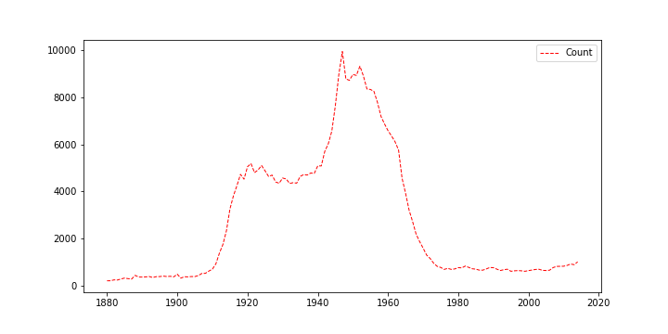
Motivating Examples
❑ Words: “There were 215 newborns named Jane in 1880, 216 in 1881, 254 in 1882, …, 927 in 2012, 898 in 2013, 1018 in 2014”
❑ Picture

Slide 7
Motivating Examples
❑ Words: “There were 215 newborns named Jane in 1880, 216 in 1881, 254 in 1882, …, 927 in 2012, 898 in 2013, 1018 in 2014”
❑ Picture
What we want to see is “trend!”

Slide 8
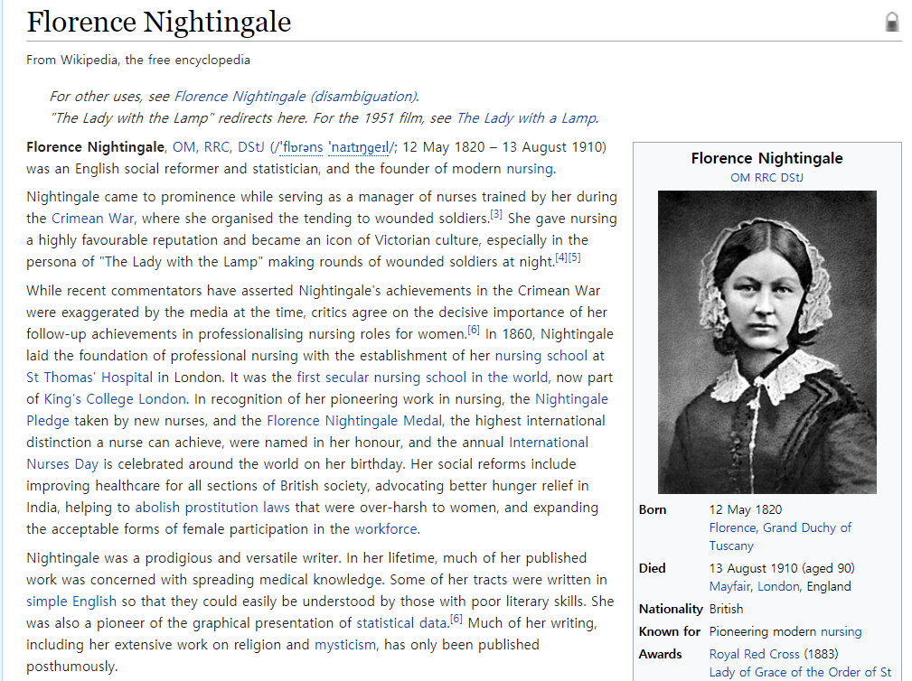
Historical Cases
❑ Florence Nightingale and health statistics

Slide 9
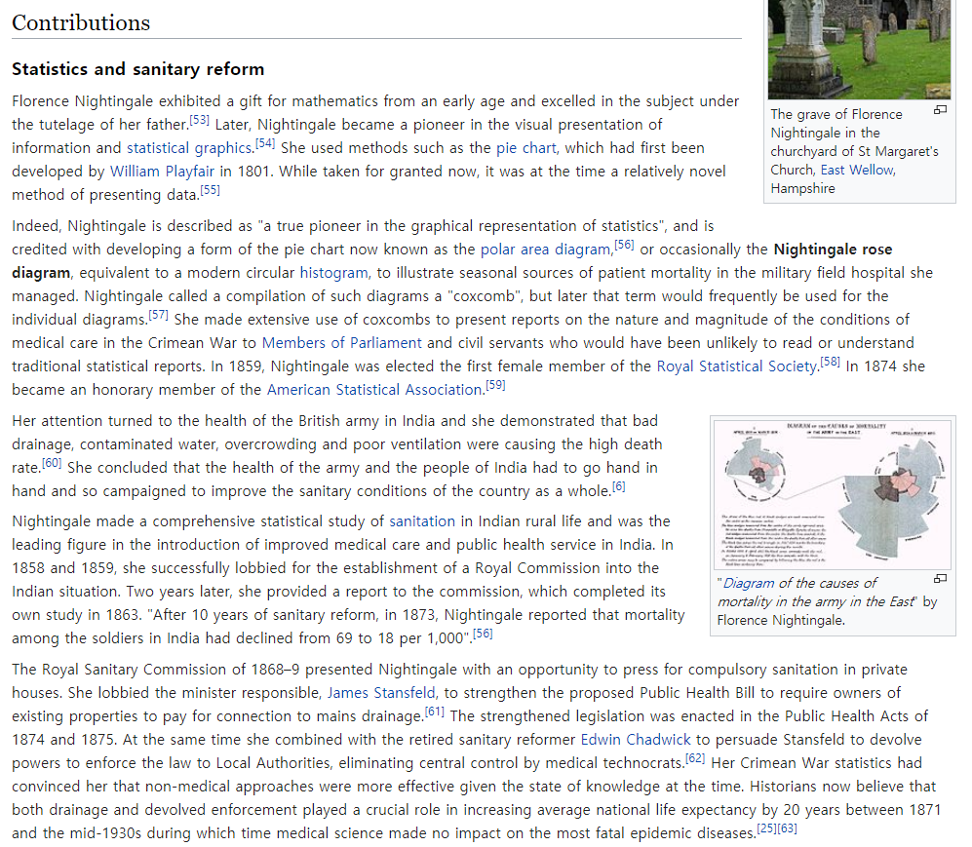
Historical Cases
❑ Florence Nightingale and health statistics

Slide 10
Data Visualization Process
❑ Acquire: Obtain the data, whether from a file on a disk or a source over a network
❑ Parse: Provide some structure for the data’s meaning, and order it into categories
❑ Filter: Remove all but the data of interest
❑ Mine: Apply methods from statistics or data mining as a way to discern patterns or place the data in mathematical context
❑ Represent: Choose a basic visual model, such as a bar graph, list, or tree
❑ Refine: Improve the basic representation to make it clearer and more visually engaging
❑ Interact: Add methods for manipulating the data or controlling what features are visible
Reference: Ben Fry, Visualizing Data (2008)

Slide 11
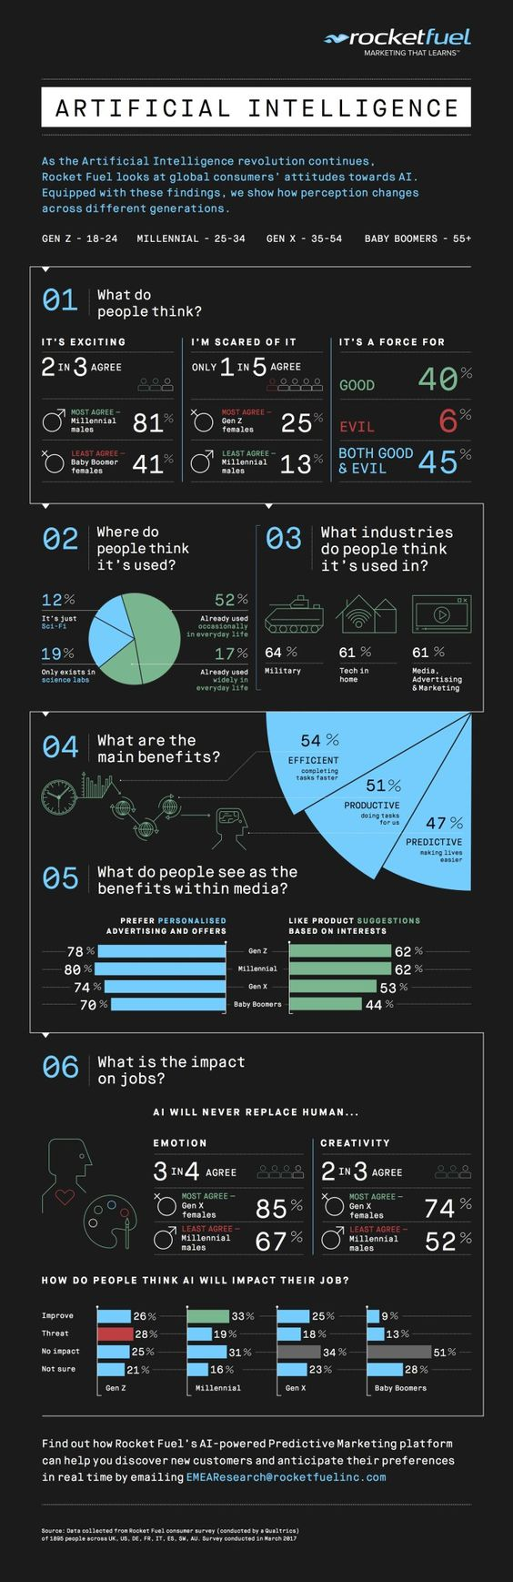
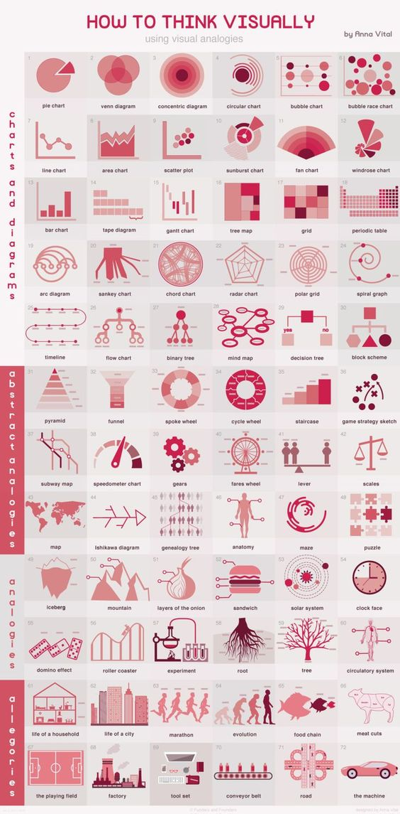
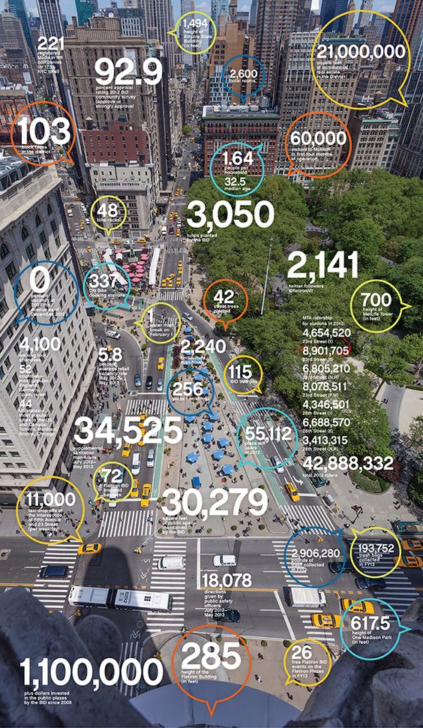
Trend
❑ Tons of ways to visualize data effectively Nowadays
Suggestions for advanced visualization:
R, Tableau, d3.js (https://d3js.org/)
src: https://www.pinterest.co.kr/explore/data-visualization-techniques/?lp=true

Slide 12
Suggestions
❑ Some advice for starters
Start with simple ones, then make it more complex and fancy by advanced techniques
- Setting your standard too high can lead you nowhere
Lower dimensions, do not try to comprise 4+ dimensions
Most people have difficulty grasping charts and plots over three dimensions
Try to keep things in 2-D space
Aesthetics is important, but functionality is more important
- Some people are obsessed with making their graphs “pretty.” But remember, it is efficiency and clarity that counts the most
❑ Some materials to look for…
https://blog.hubspot.com/marketing/data-visualization-choosing-chart
https://www.columnfivemedia.com/25-tips-to-upgrade-your-data-visualization-design
https://www.idrc.ca/sites/default/files/sp/Documents%20EN/10-data-visualization-tips-en.pdf

